Slide 1

PicWords: Render a Picture by Packing Keywords
Vineet - 2016csb1063
Sahil Gupta -2016csb1056

Slide 2
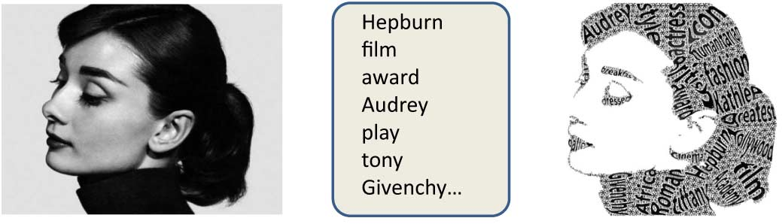
I. INTRODUCTION
When people see a beautiful picture, say, a photo of Audrey Hepburn, they may want to know more information about her. Since the picture itself cannot tell such details as the woman’s birth date, nationality, experiences, etc., they may have to resort to other sources of information, for example, texts from the Internet. On the other hand, if people read an introduction text about Audrey Hepburn, they may also long to see what she looks like directly. This kind of dilemma is very common in our daily life. So, can we design a system to generate an image, which contains Audrey’s face, and at the same time, seamlessly embeds a brief summarization of her biography? To his end, we design an automatic system called PicWords, shown in Figure It is composed of Audrey’s face as well as some key- words to briefly introduce her. In the PicWords, two modalities (picture and keywords) are seamlessly fused together to better represent the human/object of interest. The two modalities complement each other and both contribute to more exquisite art effect: the image is more intuitive and the text is more content-rich.

Slide 3
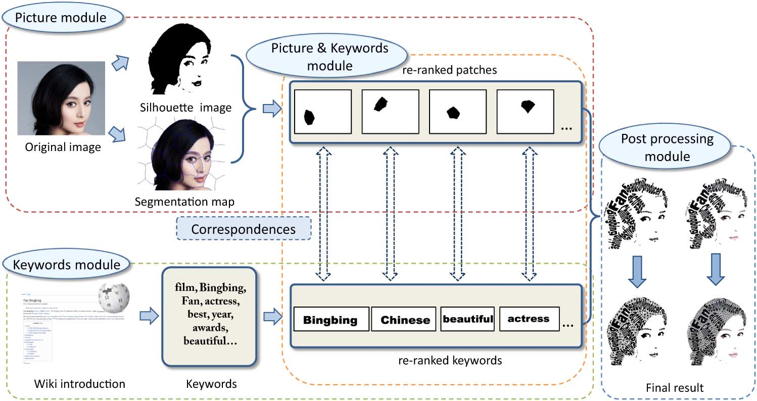
Overview - Flowchart

Slide 4
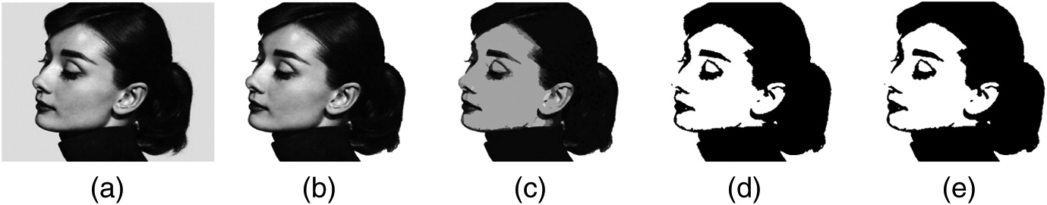
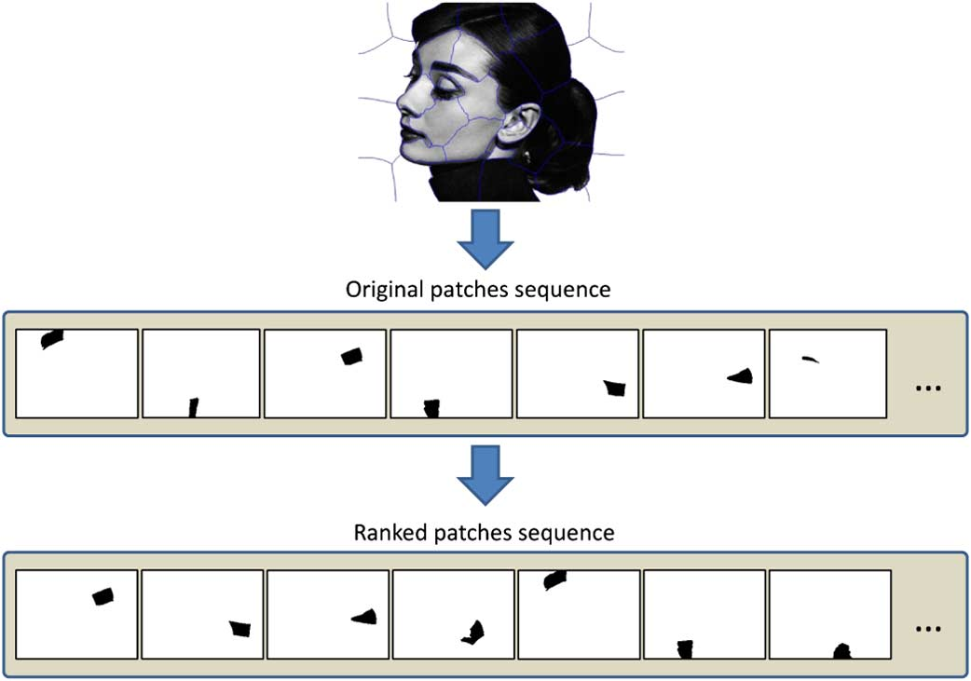
PART 1
PICTURE MODULE
The first part is picture module. Given a source image, we first generate its silhouette image. In the silhouette image, background and trivial details are filtered and only the important patches are kept.
At the same time, the original color image is segmented into several small patches with the state-of-the-art super-pixel segmentation algorithm.
Since we are only interested in filling the foreground area, only patches covered by the silhouette image are kept. After that, all the remaining patches are ranked according to how much they are suitable as a keyword container. Usually, central and long patches are supposed to rank higher.

Slide 5
1) Silhouette Image Generation
The first step in the picture module is to split the original image into a Yang part and a Yin part. The Yang part usually corresponds to object contour or important image content, and thus should be kept for keywords placing. To the contrary, the Yin part usually corresponds to background or unimportant image details, and thus can be ignored.
We first use mean shift algorithm to segment the image into small superpixels (patches). We assume that the biggest meaningless patch near the picture boundary corresponds to background and is thrown away. The foreground is also segmented out simultaneously. We can see that the spatially nearby and visually similar pixels, such as the cheek area, are clustered together in the segmentation map. Next, we convert all foreground superpixels to greyscale image, which is further thresholded into binary image. More concretely, the average luminance value of each patch is calculated, and only bright patches are kept. The threshold setting is computed automatically using Otsu’s method

Slide 6
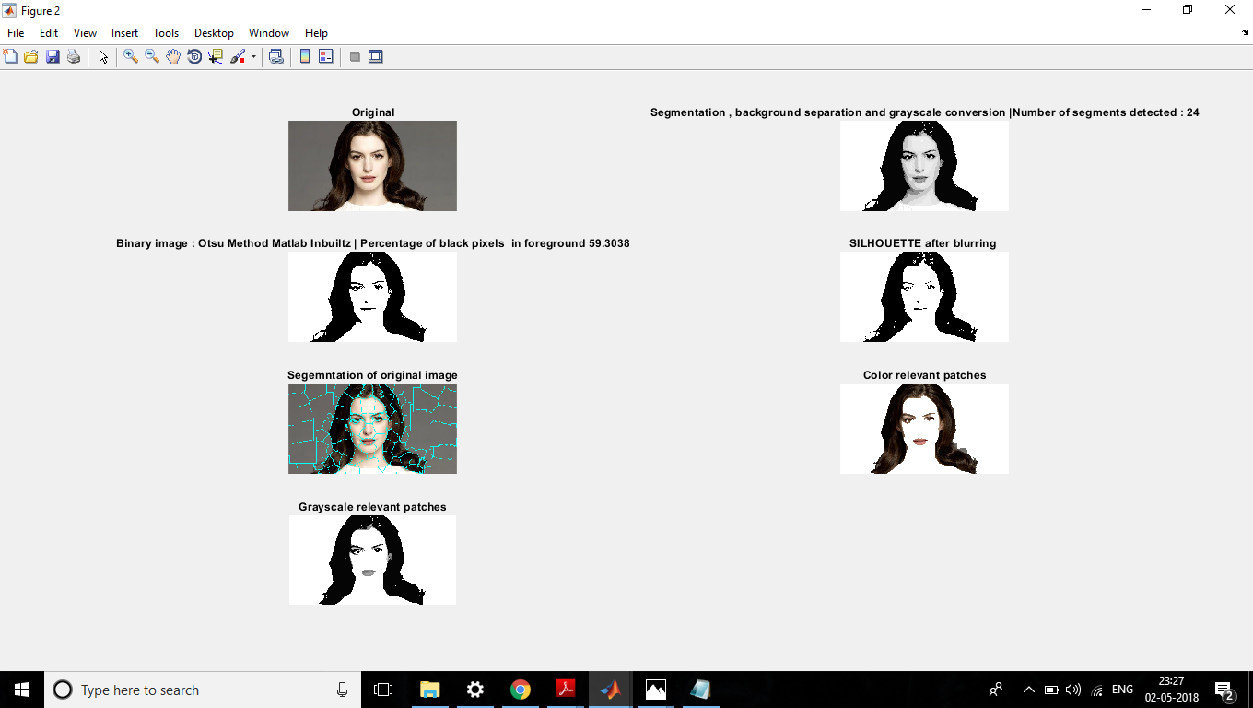
Silhouette Image

Slide 7
2) Patch Generation
Based on superpixel segmentation method, each color image is segmented into several small units as shown in the previous slide Fig. 5. Superpixel segmentation outputs a list of patches. We iterate on the list, and look for the ones which have a corresponding black patch in the Silhouette image. If the patch is present, the patch from superpixel segmentation is kept as a foreground otherwise it is discarded as a background part.

Slide 8
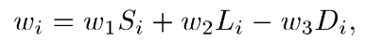
3) Patch Ranking
The results of super pixel based image segmentation are patches denoted as . However, these patches are unequally important. For example, larger patches near the center are intuitively more important. We evaluate three criteria for each patch : first, patch area, counted by pixel numbers within the region; second, patch location , indicating the distance between the patch to the center point of image; and third, patch length , calculated by the major axis of the region’s external ellipse. Based on the defined three criteria, the weight of a patch is presented as:
The weights are automatically generated according to the size of the patch.

Slide 9
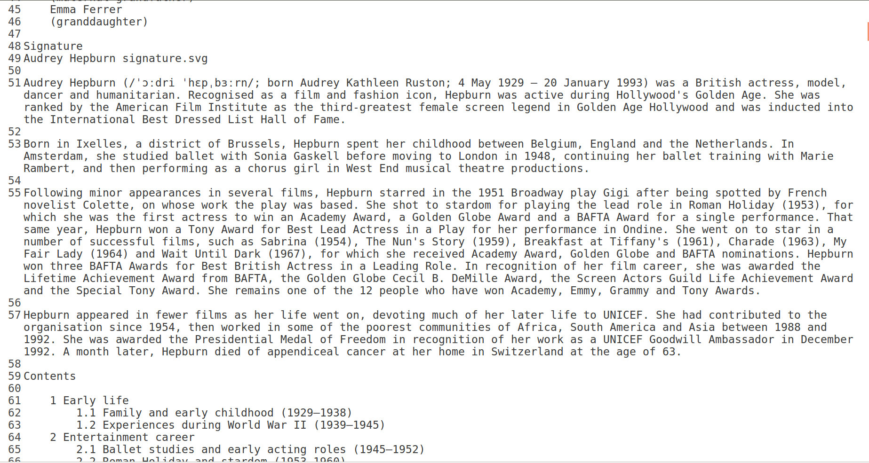
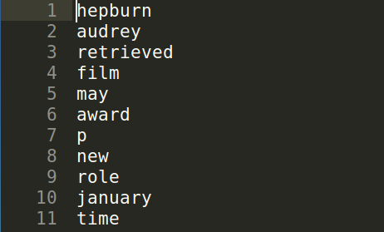
PART 2
KEYWORDS MODULE

Slide 10
Algorithm explained
There are mainly two parts in the keywords module. One is keywords collection and the other is keywords ranking.
1) Keywords Collection: The text is taken from Internet (such as Wikipedia, Twitter, Weibo, etc.) and provided in as input. Several text preprocessing techniques such as lowercasing and removing peculiars are conducted. Stop words are also removed.
2) Keywords Ranking: The collected keywords are initially ranked by their frequencies. The more frequently a word appears, the higher it is ranked. We select the top n words where n is the number of patches. We then re-rank these keywords according to their lengths. Comparing with a shorter word “film”, a longer word “Hollywood” needs a larger patch to fit in.

Slide 11
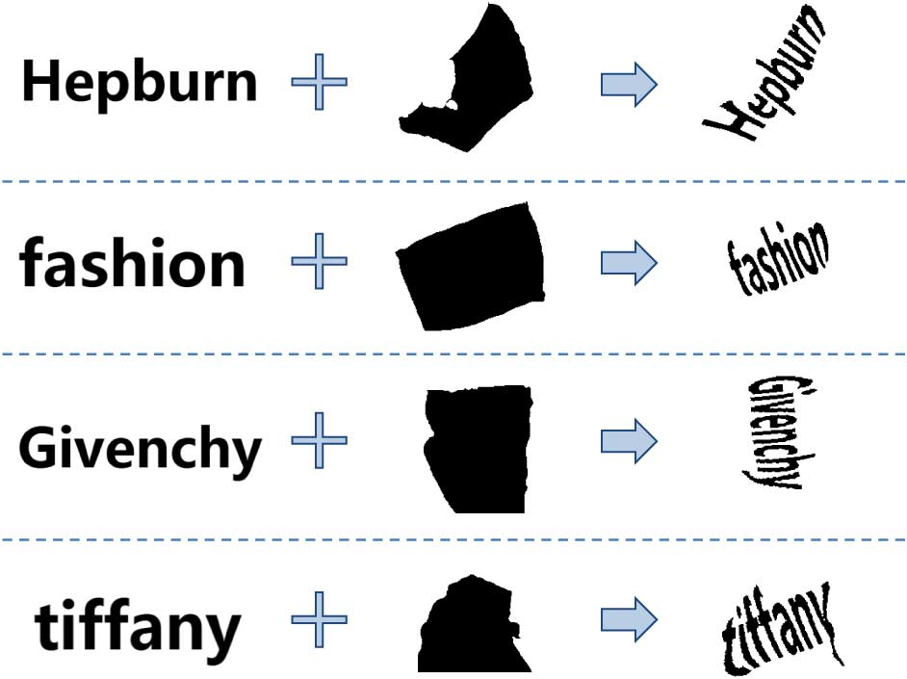
PART 3
PICTURE & KEYWORDS MODULE

Slide 12
PICTURE & KEYWORDS MODULE
1) Patch vs. Keywords Correspondence: The goal of this step is to select appropriate container patch for each keyword. The obtained ranked image patches and ranked keywords are mapped sequentially from high weight to low weight shown in figure such that: 1) the important keywords have a more salient location such as near the center; and 2) the longer keyword should be matched with a larger patch for better packing.
2) Warping Text to Image Patches: Here, the task is to warp particular keyword into an arbitrary image patch. It is quite challenging because the patch is extremely unconstrained.

Slide 13
Algorithm explained
Correspondence Points Localization: The key idea of most warping methods, is that the user must provide an explicit correspondence between the source and target shapes. Other points are mapped according to their relative positions with respect to the correspondence (anchor) points. We would like the computer to derive this correspondence automatically. We do this as following:
We compute the major and minor axis, as well as their angle bisectors, and their intersection with the region boundary. From here we get 8 points. Similarly, in the text image which is to be warped is placed on the centroid of the region and, we get the corresponding 8 points on the boundary from its intersection with the same 4 lines.

Slide 14
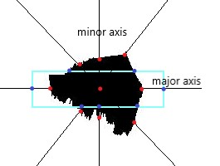
Algorithm explained
Now we have a patch and a rectangular box containing the text which is to be warped onto the patch. We do this by creating an extended version of the tie points equation but with 9 points :
X1’ = c1x + c2y + c3x^2 + c4y^2 + c5x*y + c6x^2*y + c7x*y^2 + c8x^2*y^2 + c9
Y1’ = c10x + c11y + c12x^2 + c13y^2 + c14x*y + c15x^2*y + c16x*y^2 + c17x^2*y^2 + c18
And X2’,Y2’,X3’........X9’,Y9’ are computed similarly.

Slide 15
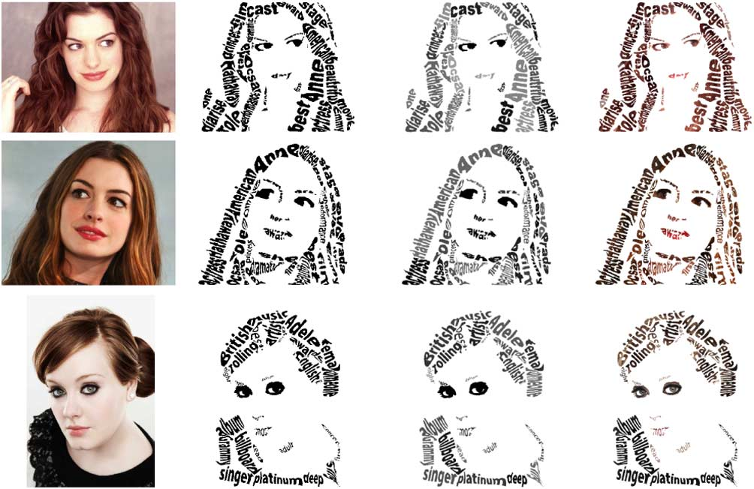
PART 4
POST-PROCESSING MODULE
In the post-processing module, several kinds of strategies can collaboratively help generate more colorful and meaningful PicWords. Given the example of stitched warped keywords, there is still blank area between keywords. Then we fill these blank space with random selected symbols (such as asterisk) for a better ornamental effect. We choose symbols instead of letters for preventing confusion with keywords. Current PicWords can only be a binary image. For better visual effects, we can also implement two variations of PicWords, i.e. the Gray PicWords and the Colored PicWords. They use the binary PicWords as a mask to pick the gray/color value of the original image, respectively.

Slide 16
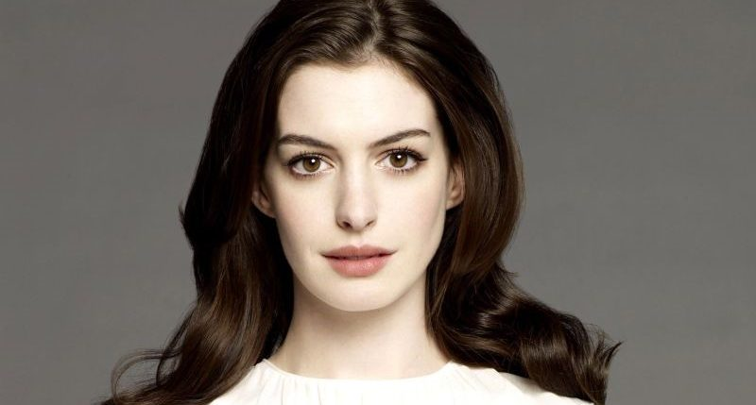
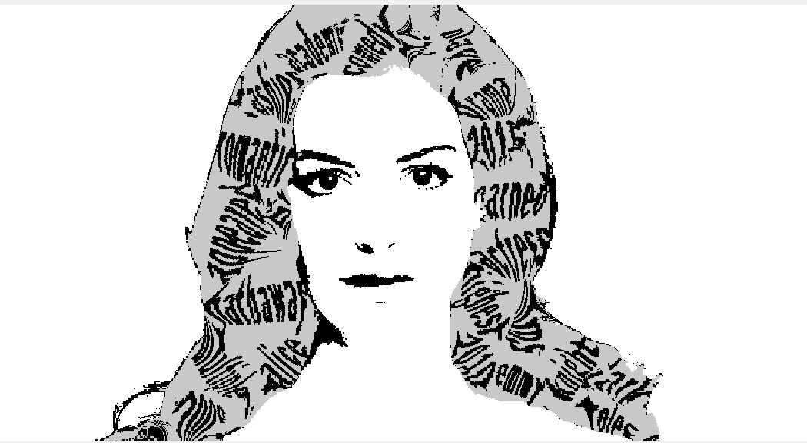
INPUT 1
OUTPUT 1

Slide 17
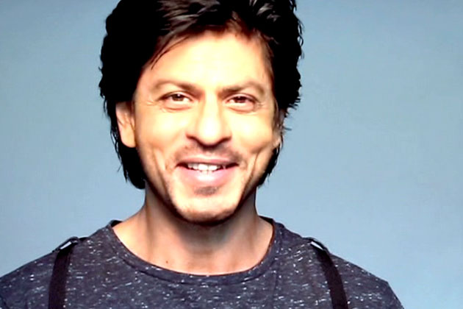
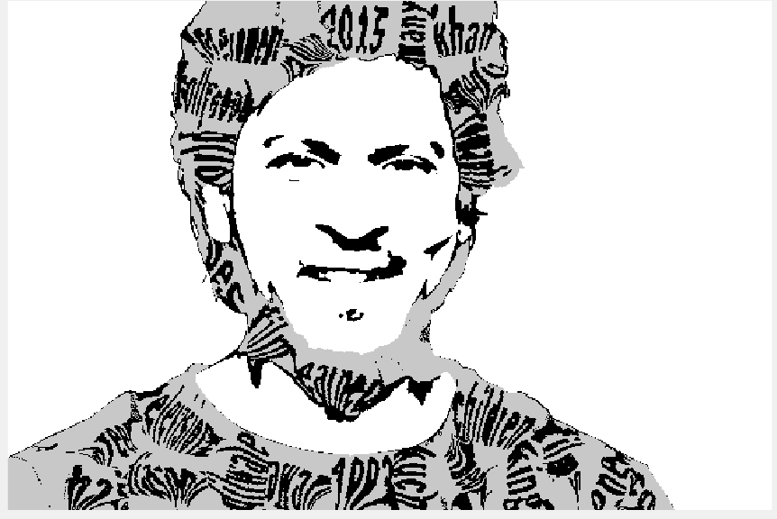
INPUT 2
OUTPUT 2

Slide 18
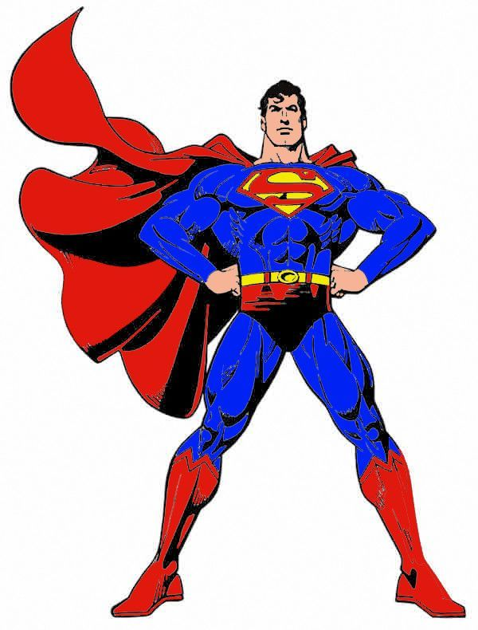
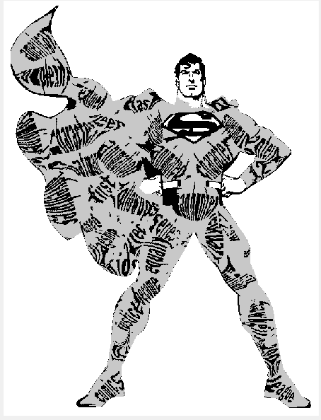
INPUT 3
OUTPUT 3

Slide 19
Further Improvements:
We require a plain background in the input image otherwise the background patches are also included in the Silhouette.
The words ranking are done on a frequency and length basis whereas advanced natural processing techniques could be used to extract words of greater importance.
Performance in the segmentation part can be used by using c-fuzzy algorithm instead on mean-shift, and the superpixel code can be optimised further.
Quality of patch generation needs to be improved, as the patch shapes and sizes could be more sophisticated and generated in accordance to the image.

Slide 20
References :
1.PicWords: Render a Picture by Packing Keywords
Zhenzhen Hu, Si Liu, Member, IEEE, Jianguo Jiang, Richang Hong, Member, IEEE, MengWang, Member, IEEE,
and Shuicheng Yan, Senior Member, IEEE
2.PicWords: Creating Pictures by its keywords
Ankur Singh1, Shruti Garg2
1 M.Tech, Department of Computer Science and Engineering, Birla Institute of Technology, Mesra, Ranchi, India.
2 Assistant Professor, Department of Computer Science and Engineering, Birla Institute of Technology, Mesra,
Ranchi, India.

